Slide 1
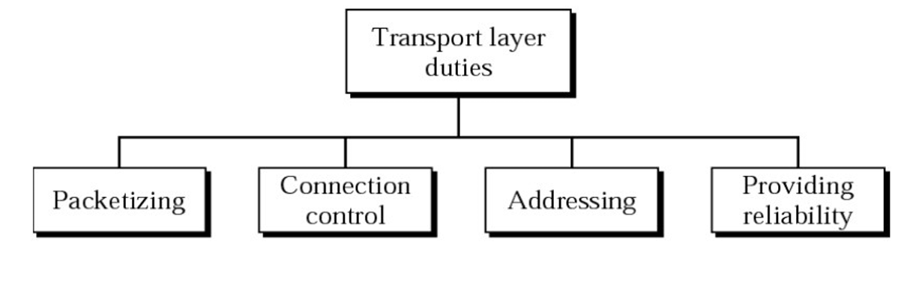

Duties of Transport Layer

Slide 2
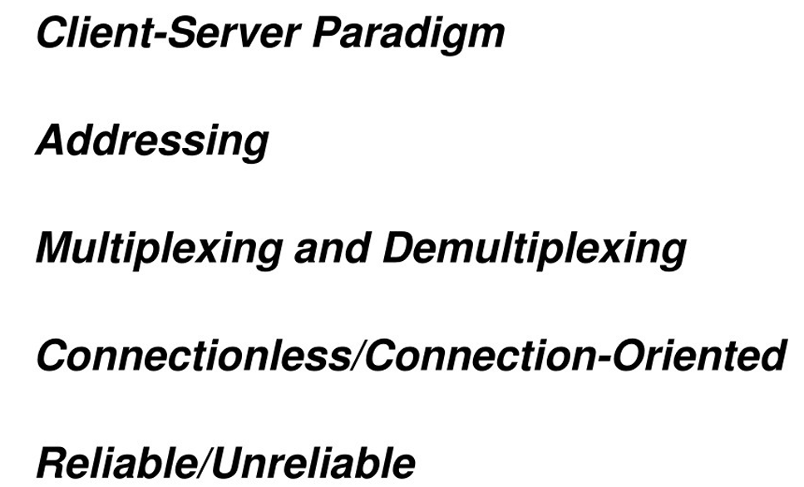
Process to Process Delivery

Slide 3
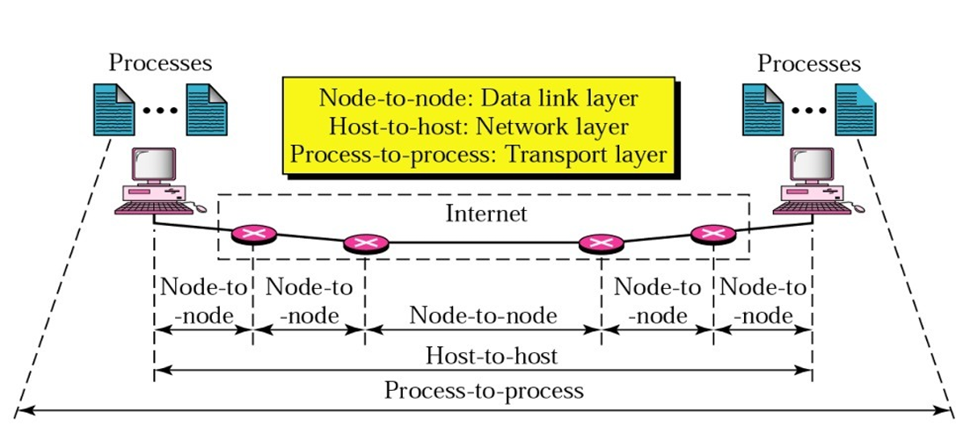
Types of data deliveries

Slide 4
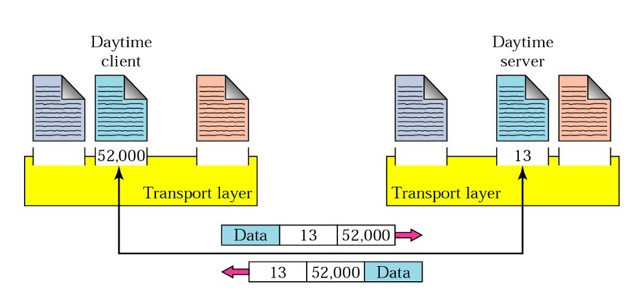
Port Number

Slide 5
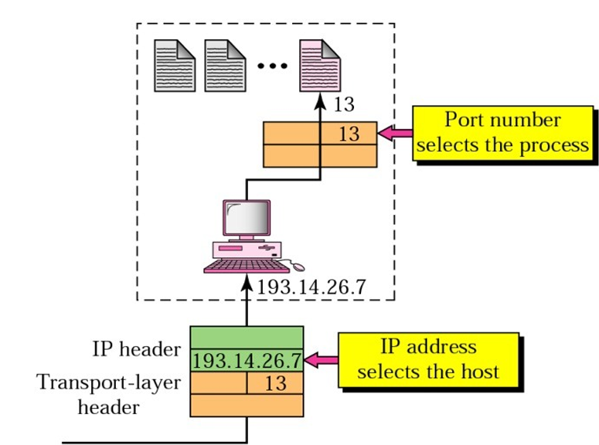
IP addresses versus Port numbers

Slide 6
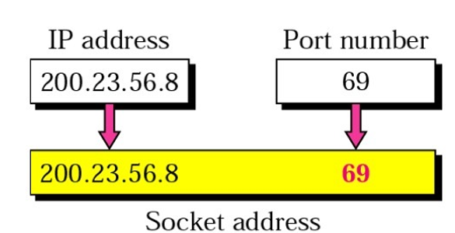
Socket address

Slide 7
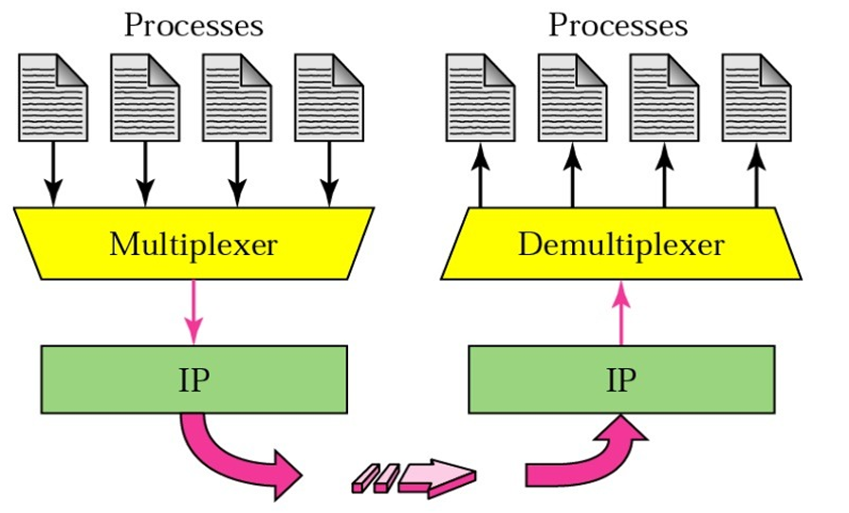
Multiplexing and Demultiplexing

Slide 8
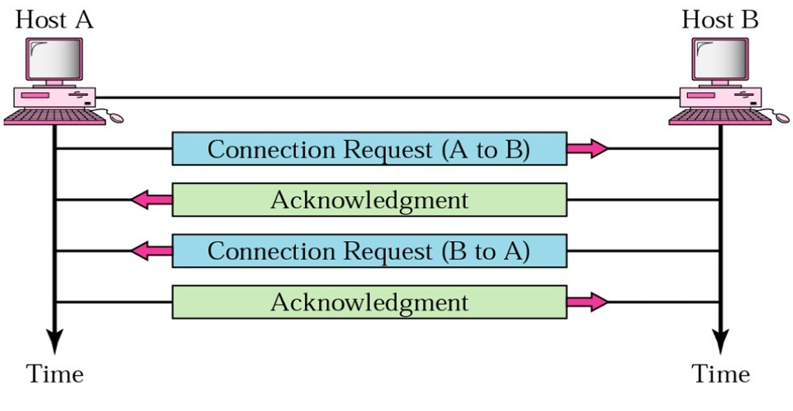
Connection Establishment

Slide 9
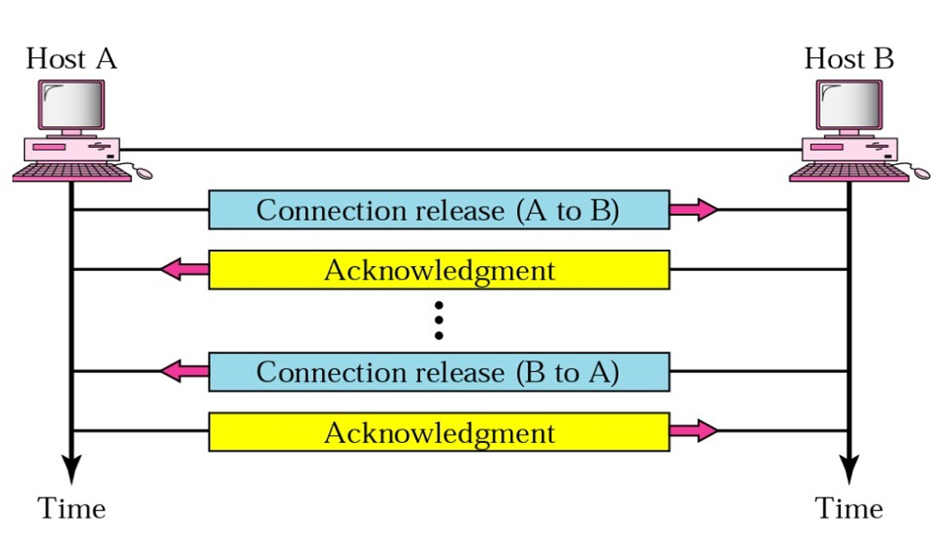
Connection termination

Slide 10
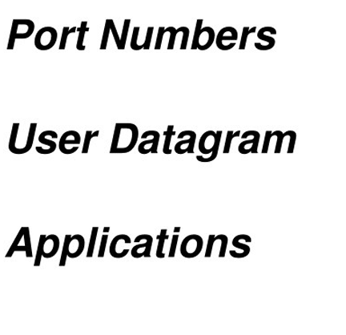
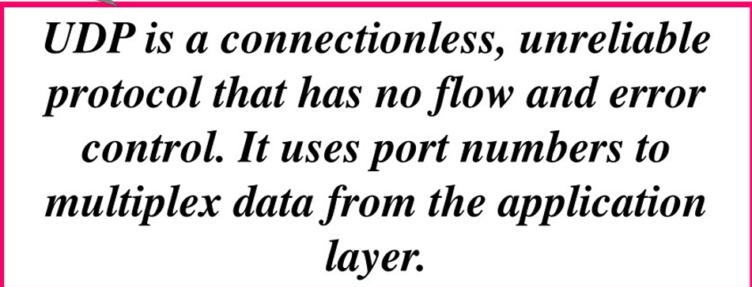
User Datagram Protocol (UDP)

Slide 11
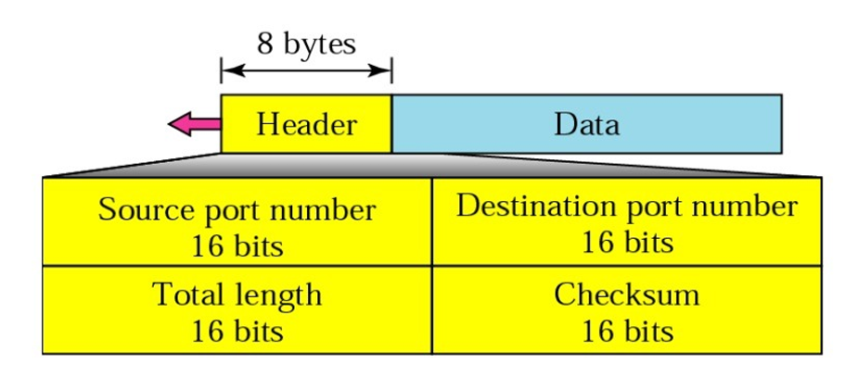
User Datagram Format

Slide 12
Multiplexing and Demultiplexing in Transport Layer
Multiplexing and Demultiplexing services are provided in almost every protocol architecture ever designed.
UDP and TCP perform the demultiplexing and multiplexing jobs by including two special fields in the segment headers: the source port number field and the destination port number field.
Multiplexing: Gathering data from multiple application processes of the sender, enveloping that data with a header, and sending them as a whole to the intended receiver is called multiplexing.
Demultiplexing: – Delivering received segments at the receiver side to the correct app layer processes is called demultiplexing.

Slide 13
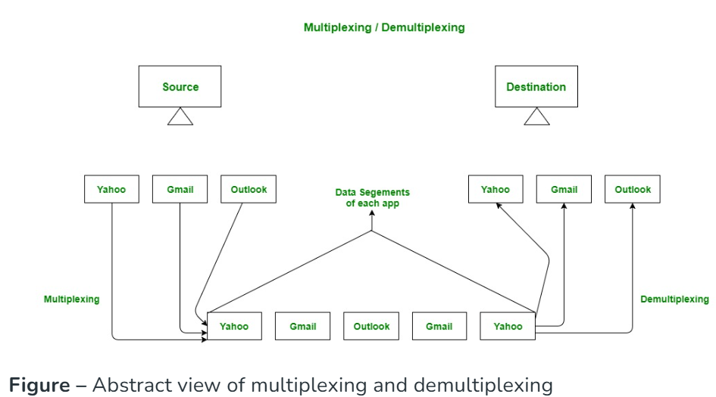
Multiplexing and Demultiplexing in Transport Layer

Slide 14
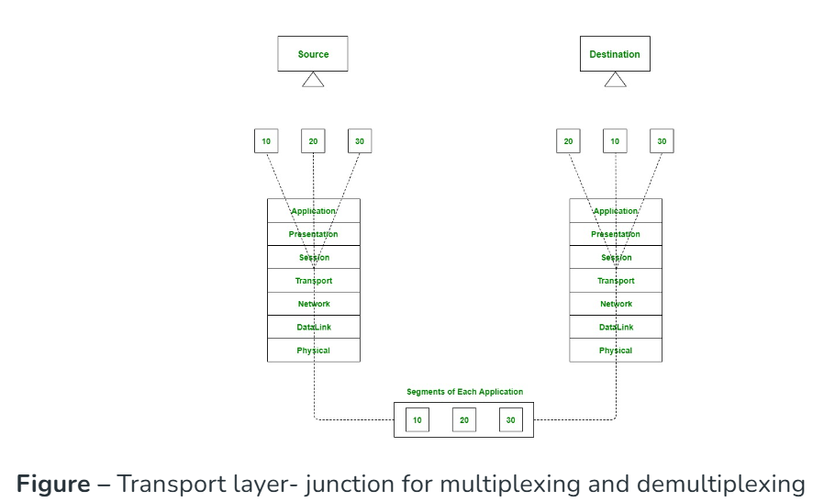
Multiplexing and Demultiplexing by Transport Layer in OSI Model

Slide 15
Types of Multiplexing and Demultiplexing at Transport Layer
Connectionless Multiplexing and Demultiplexing
Connectionless service does not require establishing any connection and termination process for transferring the data over a network.
The UDP (User Datagram Protocol) is a connectionless protocol that allows communication between two or more devices without establishing any connection.
Connection-Oriented Multiplexing and Demultiplexing
In contrast, Connection-oriented service involves the creation and termination of the connection for sending the data between two or more devices.
TCP (Transmission Control Protocol) is a connection-oriented protocol that allows communication between two or more computer devices by establishing connections in the same or different networks.

Slide 16
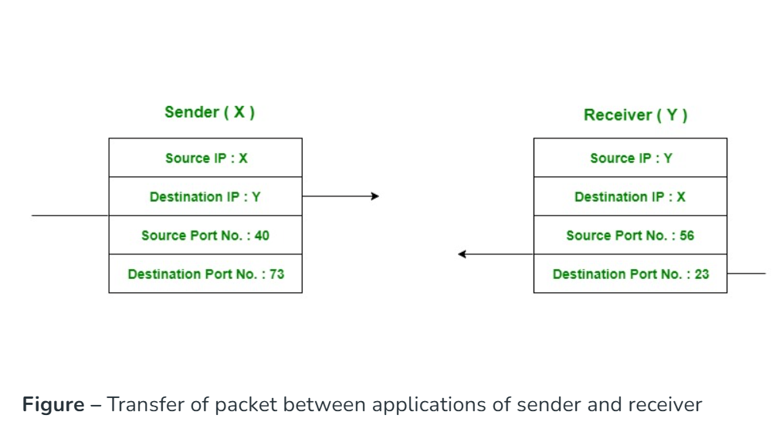
How Multiplexing and Demultiplexing is done
For sending data from an application on the sender side to an application at the destination side, the sender must know the IP address of the destination and port number of the application (at the destination side) to which he wants to transfer the data. Block diagram is shown below :

Slide 17
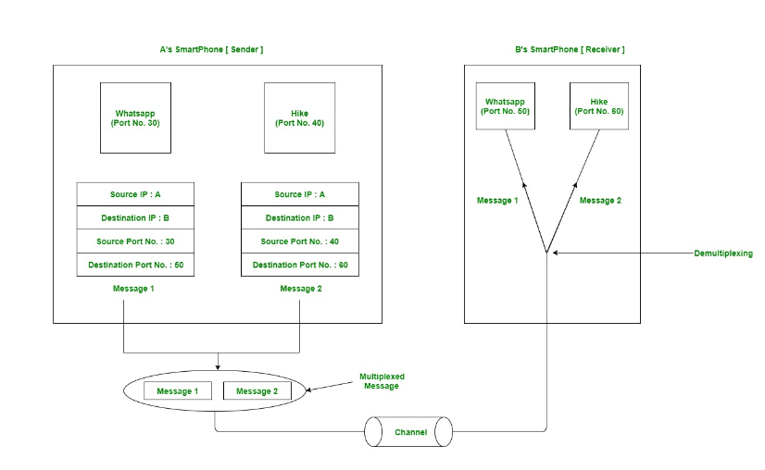
Example; Two messaging apps

